Slide 1
Games, logical agents
UI V
Mária Markošová

Slide 2
Summary of the last lecture
CSP problem, definition.
CSP examples.
Backtracking for CSP.
CSP heuristics and controls.

Slide 3

Outline
Definition of games, one agent game, two agents game.
Minimax algorithm.
prunning.
Evaluation functions.
Games and probability.
How to find a good strategy.
Introduction to logical agents

Slide 4
One player (agent) game
It is basically a searching problem
  Find a sequence of moves to get a required state
  Example: Rubik cube
  Solution by searching with an appropriate heuristics

Slide 5
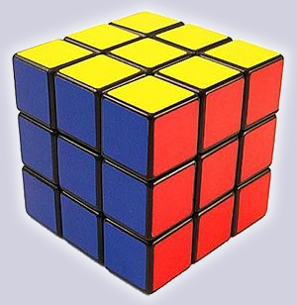
Rubik cube
Problem: Find a desirable state, on the picture from an arbitrary initial state.
Partial problems:
Find a move sequence which exchanges position of two small cubes not violating others.
example: there is known 14 ply sequence how to exchange a position of 2 corner cubes
It is a difficult searching problem

Slide 6







Heuristic steps:
1. Find a cross:
Place first corner cubes
on the first level, then
complete the first level:
3. Complete T shapes :
4. Posledná vrstva: http://peter.stillhq.com/jasmine/rubikscubesolution.html

Slide 7
Multiplayer game : multiagent environment
Multiagent environment types
Agents are cooperative
Agents are competitive
game
Game : consists of competitive agents in the multiagent environment.

Slide 8
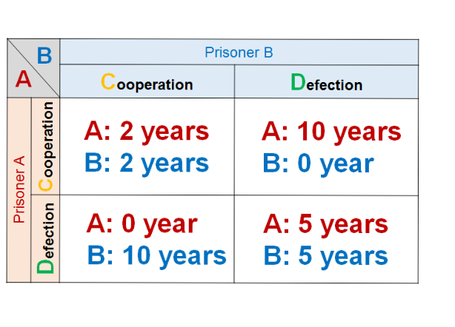
Simultaneous games
Players make decisions at the same time.
Example: Prisoner’s dilemma – described by the payoff matrix
Both prisoners A and B are interrogated at the same time and they are both told:
If you do not defect your partner, and you cooperate with him, the number of years in prison are: if your opponent cooperates too you both get 2 years in prison. If you cooperate, but your opponent defect’s you, you get 10 years and he zero. If you both defect you both get five years.

Slide 9
Prisoner’s dilemma strategies
There is only one interrogation. What is the best strategy?
There are more interrogation and you are informed what your opponent did previously, the strategy changes.
To defect.
Tit for tat is the best strategy.

Slide 10
Sequential games
The players do not decide simultaneously, but sequentially. First player makes a move and the second player answers the move.
If there are more then two players, they make alternate moves.
Example: chess
These games use evaluation function.
The rest of the lecture is devoted to the sequential games.

Slide 11
Game vs. searching problems
„Unpredictable" opponent → player has to find an answer to each opponent move
Time limit → makes a perfect solution difficult, often improbable. Player has to approximate.

Slide 12
What is a game? Summary
Game for us will be: idealized world, in which states are well defined, rules are well defined. In this world two (most simple case) competitive agents fight to gain as much utility (grades) as possible on the cost of the partner.
Environment is fully observable, deterministic, multiagent. In our case we have first two (later more) agents.
Actions of two competitive agents alternate and are done with respect to the game rules.
Utility values at the end of a game can be equal but with opposite sign. (e.g win +1, loss –1, no loss no win 0 = zero sum games).
Example: chess, tic tac toe, checkers
Episodic ?

Slide 13
Zero sum game:
In the zero sum game gain of one agent and loss of the other (or more others) agent is exactly balanced . If one gains x grades, the other gains –x.
Example: chess, checkers, etc.
We are going to speak about zero sum games here.

Slide 14

Typical properties of real games
A lot of game steps for both agents (chess about 50)
A great branching factor (chess typically about 35)
Great searching trees (chess nodes)
Agent needs to decide not knowing whether his decision is good or bad
Bad decision are quickly penalized and agent has troubles.

Slide 15
Game of two players
Agents: MAX makes the first step, MIN the second one, then alternate.
MINIMAX: Searching problem consisting of:
- initial state; board position and specification of
player which is going to make a step
- operators (successor function); list of connections ( ply, state)
- final test; is it an end of the game? Is the game in one of the
terminal states?
- utility function (payoff f.) ; gives numerical value as a game
result (1,-1,0 in chess)

Slide 16

Tic tac toe: Game tree (2-player, deterministic, turns)
Initial state
Offsprings of the initial state
Values given by the utility function.

Slide 17
Strategy: All correct moves for MAX as an answer to MIN moves
leading to the potential victory.
Problem in a game: To find an optimal strategy.
Optimal strategy: Finding MINIMAX values of each node n of the
searching tree.
Minimax-Value(n): It is an utility function value (from
the MAX point of view) in the node n. Therefore
MAX chooses moves maximizing his utility.
Minimax-Value(n)=Utility(n) if n is a terminate state

Slide 18
Utility function:
Usually it is a price which agent pays for solving the task.
In games it is a value, points, grades which agent MAX gains or
pays when the game is over.
-For zero sum games agent MIN gain such value which sums to zero with MAX value
Let us create an artificial game called MINIMAX.

Slide 19





Rules of simple game called MINIMAX
First ply (move): MAX possibilities are .
Second ply: possible answers for are , for are
etc.
Game finishes after one move of MAX and MIN, searching tree is thus two plies deep.
d) Minimax-Values of terminal states are in the interval 2 – 14.

Slide 20
We suppose:
Both players exchange their moves.
MinMax values of terminal states are bounded.
Both players play optimally, that means both try to gain as much as possible on the cost of the other player.
To gain something means to gain the best possible value at the end of the game.
These conditions are necessary conditions for MINIMAX algorithm to find the best possible move sequence.

Slide 21

MINIMAX example
Best MAX move
ply MAX
ply MIN
Utility (MinMax), values from the MAX viewpoint.
-3 -12 -8 from the MIN viewpoint

Slide 22
MINIMAX algorithm
Finds optimal strategy for MAX; supposes that both MAX and MIN play moves which are the best for them, that mean worst for the opponent. Algorithm:
Generates complete game tree by a depth first method.
Evaluates terminal states.
Propagates MinMax values from the tree leaves to the root.
To the nodes where MAX is moving the maximum of values is
given, to those where MIN is moving the minimum.

Slide 23

Minimax algorithm

Slide 24
MINMAX algorithm properties
Complete? Yes (for the finite game tree)
Optimal? Yes (if both players make an optimal moves, maximizing their profit)
Time complexity? O(b^{m})
Memory complexity? O(bm) (if depth first is used)
Chess, b ≈ 35, m ≈100 for “standard" manner of playing
→ exact solutions are in fact unreachable

Slide 25
MINIMAX example
It is up to you to tell me the values of nodes

Slide 26
Max
Min
4
7
9
6
9
8
8
5
6
7
5
2
3
2
5
4
9
3
-4 -7 -9
    Terminal nodes and their utilities (MinMax values): the numbers are given by the utility function.

Slide 27
Max
Min
4
7
6
2
6
3
4
5
1
2
5
4
1
2
6
3
4
3
Min
4
7
9
6
9
8
8
5
6
7
5
2
3
2
5
4
9
3
    other nodes: values calculated via minimax algorithm

Slide 28
Max
Min
7
6
5
5
6
4
Max
4
7
6
2
6
3
4
5
1
2
5
4
1
2
6
3
4
3
Min
4
7
9
6
9
8
8
5
6
7
5
2
3
2
5
4
9
3

Slide 29
Max
Min
5
3
4
Min
7
6
5
5
6
4
Max
4
7
6
2
6
3
4
5
1
2
5
4
1
2
6
3
4
3
Min
4
7
9
6
9
8
8
5
6
7
5
2
3
2
5
4
9
3

Slide 30
Max
5
Max
Min
5
3
4
Min
7
6
5
5
6
4
Max
4
7
6
2
6
3
4
5
1
2
5
4
1
2
6
3
4
3
Min
4
7
9
6
9
8
8
5
6
7
5
2
3
2
5
4
9
3

Slide 31
Max
5
Max
Min
5
3
4
Min
7
6
5
5
6
4
Max
4
7
6
2
6
3
4
5
1
2
5
4
1
2
6
3
4
3
Min
4
7
9
6
9
8
8
5
6
7
5
2
3
2
5
4
9
3

Slide 32
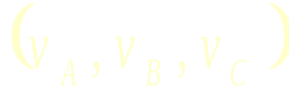
Minimax for more then two players (Maxn algoritmus)
Let us have three optimally playing agents A, B, C. Their moves alternate
Our game is one step deep ABCA.
Utility function output is a vector:

Slide 33
Principle is the same as for MINIMAX algorithm !
In a case of zero sum game two values for three players are enough.
(2,-8,6)
A
B
(2,-8,6)
(-7,5,2)
(-7,5,2)
(5,-10,5)
C
(2,-8,6)
(6,-8,2)
A
(2,-8,6)
(-5,2,3)
(6,1,-7)
(6,-8,2)
(5,1,-6)
(-7,5,2)
(-8,7,1)
(5,-10,5)

Slide 34
MINIMAX variants
If the game tree is too deep:
1. Minimize number of searched branches.
2. Cut the tree at some depth.
3. Use heuristic function to evaluate nodes.
cutt – off search
α − β pruning

Slide 35
α − β pruning
Method : gives the same moves as MINIMAX, but prunes searching
unpromising branches.
MINIMAX is usually implemented as α − β pruning.

Slide 36
MINIMAX example
Best MAX move
ply MAX
ply MIN
Utility (MinMax), values from the MAX viewpoint.
-3 -12 -8 from the MIN viewpoint

Slide 37

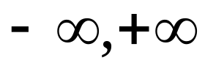
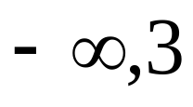
α-β pruning example (from Russel Norwig book)

Slide 38
α-β pruning example

Slide 39
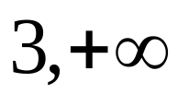
α-β pruning example

Slide 40

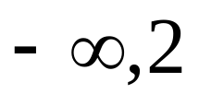
α-β pruning example
If the value is less then 2, MAX will not go here. If greater then 2 MIN will not choose it.

Slide 41

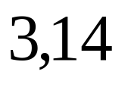
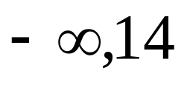
α-β pruning example

Slide 42

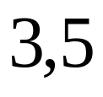
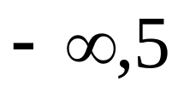
α-β pruning example

Slide 43

α-β pruning example
Would change of order of searched branches help here?
2
Minmax-value(root)=max(min(3,2,12), min(2,x,x), min(4,5,2)) = max(3, min(2,x,y),2) = 3

Slide 44
Properties of α-β pruning
Pruning does not change the final result.
Branch order has a great influence on the pruning algorithm.
Perfect order in pruning gives the time complexity = O(b^{m/2})
  → for the same time available we are able to search to the double depth.

Slide 45
Order of successor generation influences algorithm effectivity.
Heuristics for ordering is important.
2
Generating this node as a first one, two next branches are pruned.

Slide 46
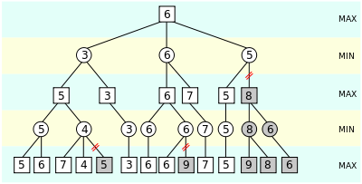
Another example of alpha –beta pruning

Slide 47
Alfa beta pruning, example.
Tell me the node values.

Slide 48
[-∞, +∞]
5
Max
[-∞, +∞]
Min
  α best choice for Max ?
  β best choice for Min ?
  we assume a depth-first, left-to-right search as basic strategy
  the range of the possible values for each node are indicated
    initially [-∞, +∞]
    from Max’s or Min’s perspective
    these local values reflect the values of the sub-trees in that node;
    the global values α and β are the best overall choices so far for Max or Min

Slide 49
[-∞, +∞]
5
Max
[-∞, 7]
Min
7
  α best choice for Max ?
  β best choice for Min 7
  Min obtains the first value from a successor node

Slide 50
[-∞, +∞]
5
Max
[-∞, 6]
Min
7
6
  α best choice for Max ?
  β best choice for Min 6
  Min obtains the second value from a successor node

Slide 51
[5, +∞]
5
Max
5
Min
7
6
5
  α best choice for Max 5
  β best choice for Min 5
  Min obtains the third value from a successor node
  this is the last value from this sub-tree, and the exact value is known
  Max now has a value for its first successor node, but hopes that something better might still come

Slide 52
[5, +∞]
5
Max
5
[-∞, 3]
Min
7
6
5
3
  α best choice for Max 5
  β best choice for Min 3
  Min continues with the next sub-tree, and gets a better value
  Max has a better choice from its perspective, however, and will not consider a move in the sub-tree currently explored by Min
    initially [-∞, +∞]

Slide 53
[5, +∞]
5
Max
5
[-∞, 3]
Min
7
6
5
3
  α best choice for Max 5
  β best choice for Min 3
  Min knows that Max won’t consider a move to this sub-tree, and abandons it
  this is a case of pruning, indicated by

Slide 54
[5, +∞]
5
Max
5
[-∞, 3]
[-∞, 6]
Min
7
6
5
3
6
  α best choice for Max 5
  β best choice for Min 3
  Min explores the next sub-tree, and finds a value that is worse than the other nodes at this level
  if Min is not able to find something lower, then Max will choose this branch, so Min must explore more successor nodes

Slide 55
[5, +∞]
5
Max
5
[-∞, 3]
[-∞, 5]
Min
7
6
5
3
6
5
  α best choice for Max 5
  β best choice for Min 3
  Min is lucky, and finds a value that is the same as the current worst value at this level
  Max can choose this branch, or the other branch with the same value

Slide 56
5
5
Max
5
[-∞, 3]
[-∞, 5]
Min
7
6
5
3
6
5
  α best choice for Max 5
  β best choice for Min 3
  Min could continue searching this sub-tree to see if there is a value that is less than the current worst alternative in order to give Max as few choices as possible
    this depends on the specific implementation
  Max knows the best value for its sub-tree
Notes:
Odpoved na otazku, nie je to jedno. Hodnoty v poslednej orezanej vetve nebudu vacsie ako 5, lebo by tam nesiel min. Mozu byt mensie ako 5 a potom by tam nesiel Max, Max teda pojde tam, kde je strom rozvinuty az po poslednu hladinu (ma davat tie iste tahy ako jednoduchy Minimax.)

Slide 57

The α-β algorithm

Slide 58

The α-β algorithm
Notes:
Obmena minimaxu: Bezziskova hra pre MINa: Napriklad ak utility hodnoty listov su financnym ohodnotenim pre MAXa. Max chce najvacsi zisk, MIN vie, ze neziska nic, ale chce branit v zisku MAXovi. Cize vybera minimalne utility z hladiska MAXa, aj ked z toho on sam profit nema.

Slide 59
Cons of
α-β pruning
Not always optimal node ordering.
At least for a part of the tree we have to reach bottom level of the tree. This can be a problem for a very deep game trees.

Slide 60
If the game tree is too deep
Cut the tree at some appropriate depth.
Except of real minimax values, we used estimated heuristic values. Values are outputs of the heuristic evaluation function.
Evaluation function : gives values of nodes at the cut offed level of the tree.
If good: -orders the nodes the same way as the exact utility
function
-heuristic values calculation cannot be too time consuming
-heuristic values should give a good estimate of the win chance

Slide 61
Cutting off search
Can be used as a variant of α-β pruning. If the branch is cut off sooner then at the final tree depth, evaluation function estimates its value. Estimated values are further taken as MinMax values.

Slide 62
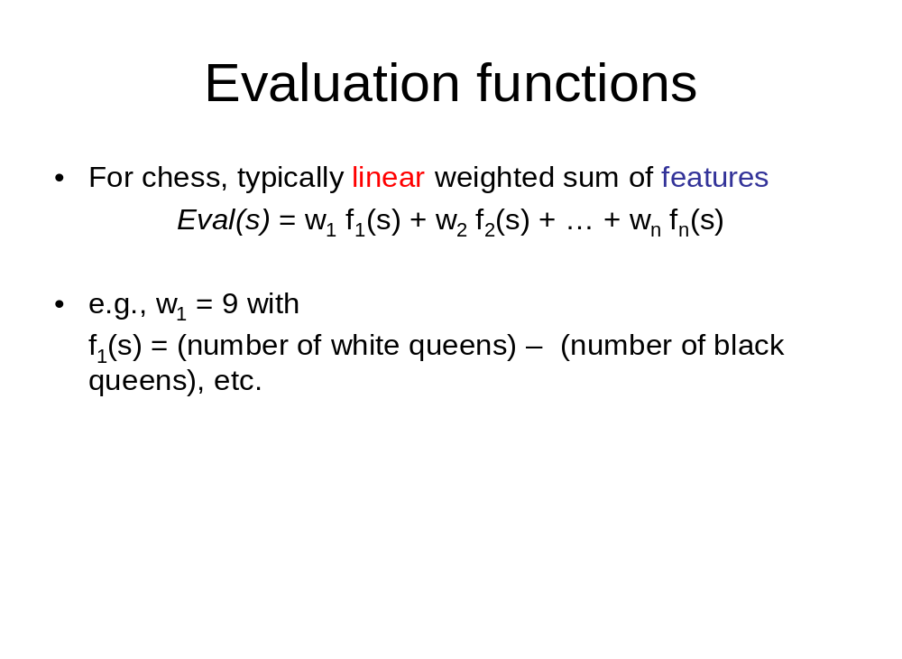
Evaluation functions – some remarks
Weighted game features, for example. Features are chosen and functions created by experts.
Number of certain stone types at certain positions
Chess
Stone values, strengths

Slide 63
Cons of linear evaluation functions
they are based on the anticipation that features are independent, which is not always true ( for example strengths of chess stone is independent of the strengths and configuration of other chess stones – definitely not true)
Therefore complicated nonlinear evaluation functions were created for various games, taking into account strength of the feature combination.

Slide 64
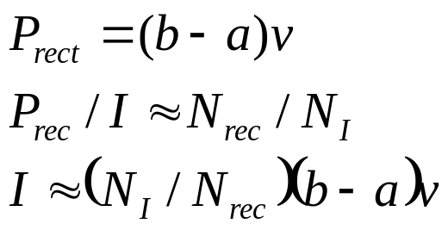
Using Monte Carlo methods in the games
Monte Carlo principle:
We want to calculate a complicated definite integral which is difficult to do analytically.
Definite integral is an area
under the curve.
2. Close it into the rectangle.
Generate random points in
the rectangle.
4. Estimate the integral I.
f(x)
v
a
x
b

Slide 65
Using Monte Carlo methods in the games
Monte Carlo method are based on sampling.
Let players play the game. At the first step then can make random moves.
2. This way the search tree is sampled.
3. Evaluate number of wins and losses for the games going through
certain nodes.
More about it in the master course of AI.

Slide 66
Expectiminimax
Algorithm searching for the optimal player moves, if they depend on some uncertainty, for example dice throwing.
Example: backgammon.
Minimax tree contains MIN, MAX and DICE levels.

Slide 67
Expectiminimax tree example
MAX
DICE
3
4.6
5.5
0,5
1/3
1/3
0,5
1/3
0,5
0,5
5
1
2
3
9
4
7
MIN
DICE
3.0
1.5
0,5
0,5
0,5
0,5
2
1
1
5

Slide 68
Questions
If MinMax values are multiplied by some constant, does it influence the best moves? If yes , why? If no, why?
Let us have a game:
-A, B players exchange moves. Each have to move to a closest empty square independently of the direction.
-if opponent occupies the closest square, player can jump over to the next closest one
- (1, ak prvý skončí A, -1 ak B, 0 ak obaja naraz) game finishes if A is at the position of B and vice versa (1, if A finishes first, -1 if B, 0 if both )
A
B
1 2 3 4

Slide 69
Tasks:
Draw a complete game tree. State is a vector containing positions of both agents.
Evaluate terminal states.
Generalize for n squares and prove that n>2 A wins if n is even and B wins if n is odd.

Slide 70
Summary
Game and „zero sum“ game definition.
MINIMAX algorithm and its variants.
alfa-beta pruning
cutoff search
Evaluation function remarks
Expectiminimax. Monte Carlo in games.

Slide 71
Logical Agents I
UI VI
Mária Markošová

Slide 72
Summary from the last lecture
Game in AI, definition, one player games
Multiplayer games, simultaneous games, sequential games.
MINIMAX algorithm and zero sum games.
Alpha beta pruning.
Cut off search and evaluation functions.
Monte Carlo method and games.

Slide 73
Outline
Logical agents
Wumpus world and knowledge base.
Propositional logic.
Inference methods in propositional knowledge base.

Slide 74
Logical agents
Knowledge base agent: KB agent
KB agent has a knowledge base (KB) implemented in which knowledges about the environment and its changes are stored. KB agent has inference methods implemented, together with learning unit. KB agent is able to learn, inference a new knowledges from the old ones. For logical agents KB consists of logical sentences. Propositional KB means, that KB is written in the propositional logic.

Slide 75
Knowledge based agent
What contains KB agent?
KB, knowledge base in which knowledges about the world in which agent acts are stored. .
Background knowledge base; can be empty
Inference mechanism.
How the KB agent works?
It tells KB, what it currently percepts using the TELL function.
It asks KB what is the best current action. ASK function.

Slide 76

Tell: Sentence adding function, adds new sentences into KB
Ask: Function asking about the knowledges stored in the KB, function wich chooses the best possible agent action.
Current percept is added into KB
Asks KB about the current action
Writes changes into KB, which were caused by the current action

Slide 77
Wumpus world
Environment: Wumpus world is a square lattice. Agent is placed at certain square, wumpus, gold and pits are environment features. Start: agent at the position [1,1]
Goal: To find a gold, to avoid a pit, not to be eaten by wumpus, bring the gold to the position [1,1]
Agent: agent does not percept its own position, agent knows the state of the current square

Slide 78

Wumpus World PEAS description (Russel, Norwig)
Performance measure
  gold +1000, death -1000
  -1 per step, -10 for using the arrow
Environment
  Squares adjacent to wumpus are smelly
  Squares adjacent to pit are breezy
  Glitter if gold is in the same square
  Shooting kills wumpus if you are facing it
  Shooting uses up the only arrow
  Grabbing picks up gold if in same square
  Releasing drops the gold in same square
Sensors: Stench, Breeze, Glitter, Bump, Scream
Actuators: Left turn, Right turn, Forward, Grab, Release, Shoot
agent bumped the wall
wmpus is killed

Slide 79
Percept: five position vector
(stench, breeze,glitter,bumb,scream)
(zápach, vánok,ligot,buchnutie,výkrik)
Simple percept representation?
binary vector of the length 5
Current percept: example
(stench, breeze, none, none ,none)
or
(1, 1, 0, 0 ,0)
Agent percepts gold
Agent bumps into thr wall
Agent hits wumpus by arrow

Slide 80
„Wumpus world“ features
Observable? No – percept of the agent is local
Deterministic? Yes
Epizodic? No
Static Yes – wumpus and pits are features, not agents
Discret? Yes
Single agent? Yes, wumpus is a property of the environment not an agent

Slide 81
Background KB for the „wumpus world“
Background KB contains knowledges common for all wumpus worlds, for all configurations of pits, gold, wumpus.
This KB contains sentences as:
neighbour squares of wumpus are „smelly“
squares near pits are „breezy“
in the wumpus worlds is exactly one wumpus and exactly one agent
agent starts at the position (1,1)
etc

Slide 82


Exploring wumpus world
breeze (vánok)
stench (zápach)
(stench, breeze,glitter,bumb,scream)
(none,none,none,none,none)
(0,0,0,0,0)
Current percept

Slide 83

Exploring a wumpus world
(stench, breeze,glitter,bumb,scream)
breeze
stench
(none,breeze,none,none,none)
(0,1,0,0,0)
Current percept

Slide 84

Exploring a wumpus world
(stench, breeze,glitter,bumb,scream)
breeze
stench
(none,breeze,none,none,none)
Current percept

Slide 85

Exploring a wumpus world
(stench, breeze,glitter,bumb,scream)
breeze
stench
(stench,none,none,none,none)
(1,0,0,0,0)
Current percept

Slide 86

Exploring a wumpus world
breeze
stench

Slide 87

Exploring a wumpus world
(stench, breeze,glitter,bumb,scream)
breeze
stench
(0,0,0,0,0)
Current percept

Slide 88

Exploring a wumpus world
breeze
stench

Slide 89

Exploring a wumpus world
(stench, breeze,glitter,bumb,scream)
breeze
stench
(1,1,1,0,0)
aktuálny vnem

Slide 90
How to tell KB new percepts and knowledges? By what kind of language?
Logical agent: the language is logic
What is logic?
It is a science about correct reasoning on the symbolic level. The concrete content of sentences is ignored.
Propositional logic
First order logic

Slide 91
Logic
Logic consists of:
Formal problem describing system syntax and semantics
Theory of logical proofs and logical reasoning, rules of logical reasoning.
Logical reasoning: On the basis of logical rules and relations we derive from the known sentences the unknown ones. We are dealing with propositional logic in this lecture.

Slide 92
Interpretation: It is an assignment of meaning to the logical symbols. In propositional logic it is a mathematical abstraction of the real world in which we know the truth values of each sentence.
Model: Mathematical abstraction of the real world in which the sentence has a value True or 1 which means true.
Example: logical sentence
Model of the sentence
1 1 1 1 1 1 0 1

